Slide 1
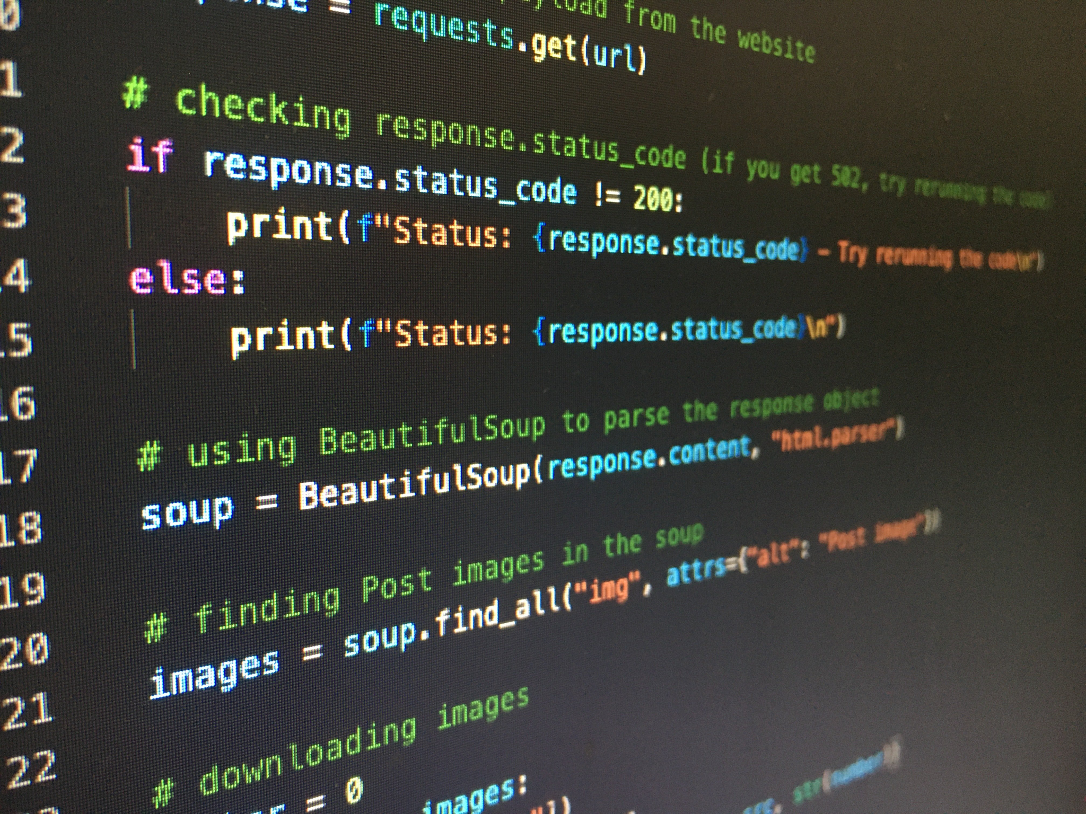

Get Started with Python

Slide 2
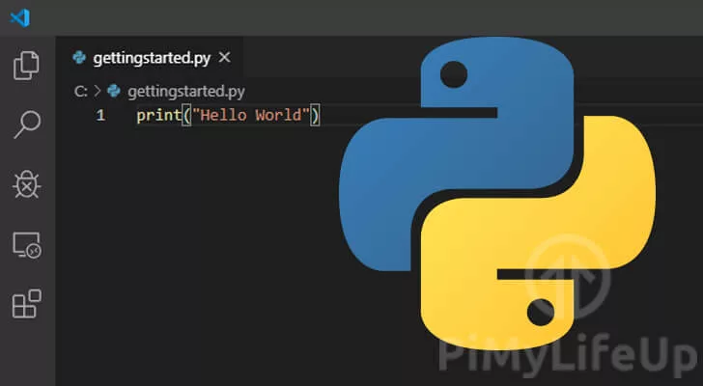
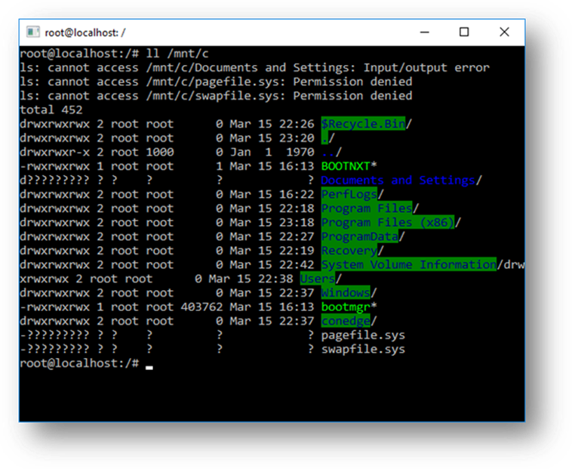
Get Started with Python

Slide 3
Introduction
Python is a popular programming language. It was created by Guido van Rossum, and released in 1991
Web development (server side)
Software development
Industrial 4.0 applications (IoT, AI, Data Analytics)
https://www.w3schools.com/python/python_intro.asp

Slide 4
Python IDE for Programming
Windows sub-Sytem for Linux (WSL)
Visual Studio Code
Pycharm
Notepad - Terminal
Online Python editor:
https://www.programiz.com/python-programming/online-compiler/

Slide 5
Python Indentation
if 5 > 2:
print("Five is greater than two!")
if 5 > 2:
print("Five is greater than two!")
Tab or spaces is used for indentation

Slide 6
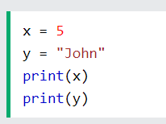
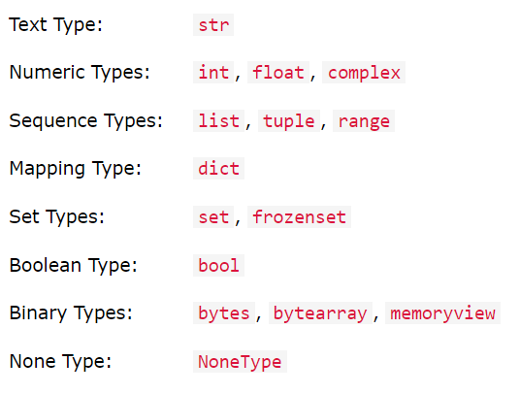
Python Variable and Data Type
https://www.w3schools.com/python/python_variables.asp
https://www.w3schools.com/python/python_datatypes.asp

Slide 7
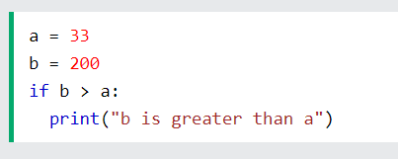
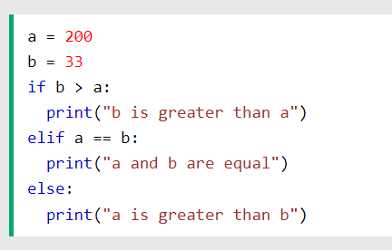
If Statement
https://www.w3schools.com/python/python_conditions.asp

Slide 8
ArrayS in Python
https://www.w3schools.com/python/python_arrays.asp
a = [1, 2, 3, 4, 5]
print(a[0])

Slide 9
FOR Loop
a = [1, 2, 3, 4, 5]
N = len(a)
for i in range (0, N):
print(a[i])

Slide 10
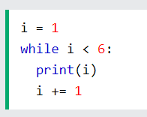
WHILE Loop
https://www.w3schools.com/python/python_while_loops.asp

Slide 11
Function
https://www.w3schools.com/python/python_functions.asp
def sum_numbers(a, b):
result = a + b
return result
c = 4
print(sum_numbers(c, 3))

Slide 12
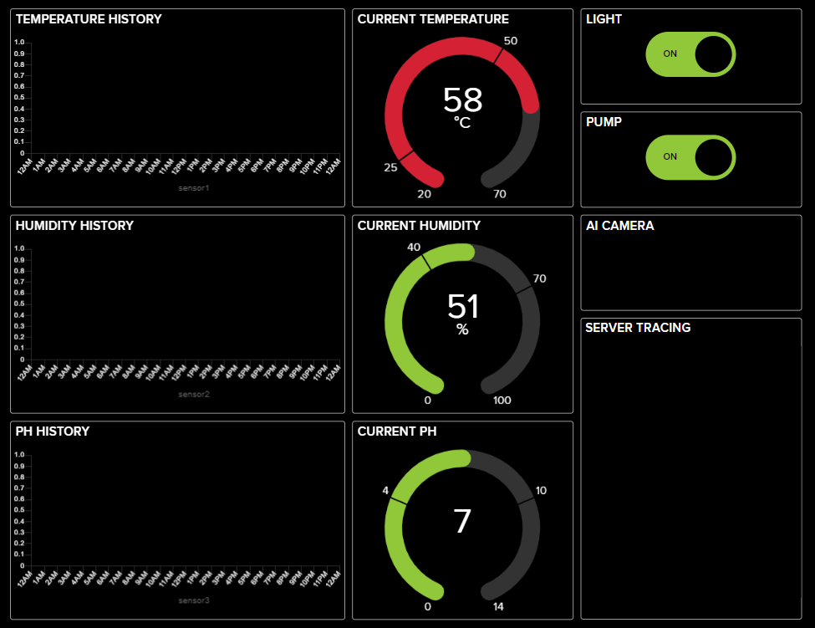

Internet of Things with Python

Slide 13
Create an Account in Adafruit IO
https://io.adafruit.com/
Create an account for your group
The account can be shared, but your key cannot be shared or public to Github

Slide 14
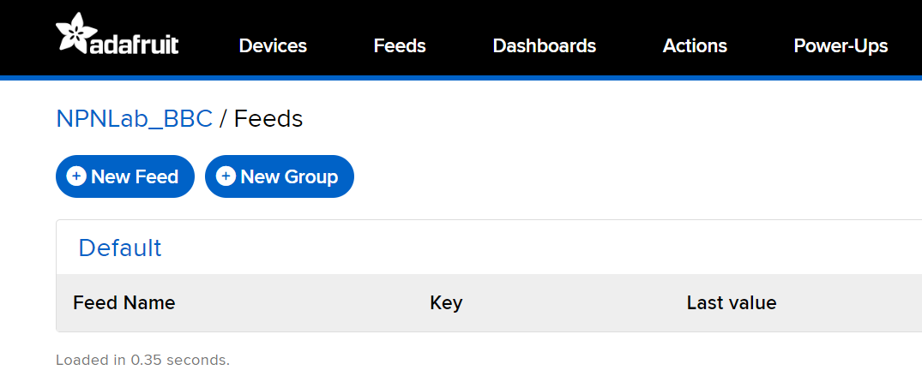
Feeds and Dashboard
Feeds is the backend of the server
Dashboard is the frond end of the server

Slide 15
Step 1: Create feeds in AIO
Feed name should be lower-case and without special character
Create 3 feeds for sensor data:
sensor1, sensor2, sensor3
Create 2 feeds for button:
button1, button2
Create 1 feed for the AI
ai

Slide 16
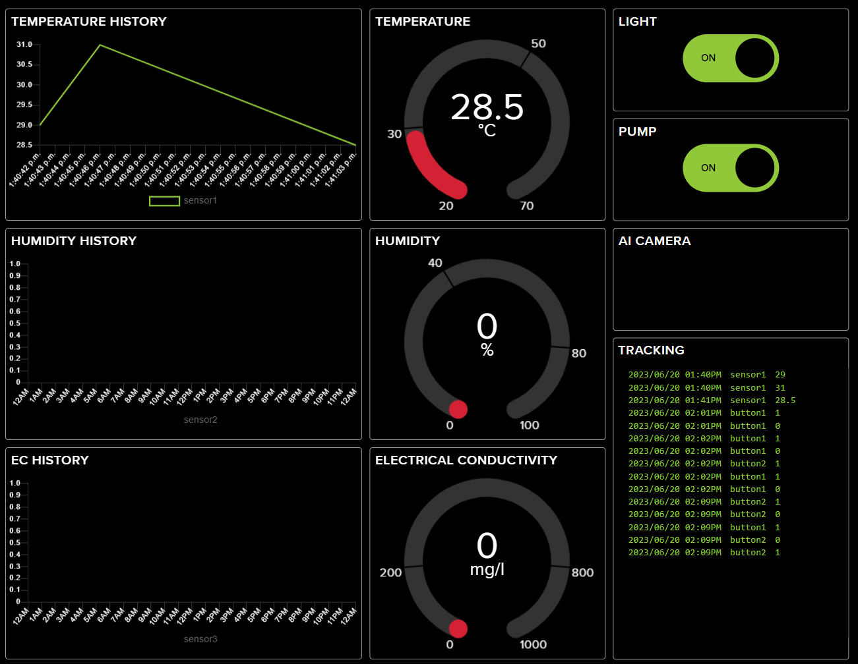
Step 2: Create Dashboard in Adafruit IO

Slide 17
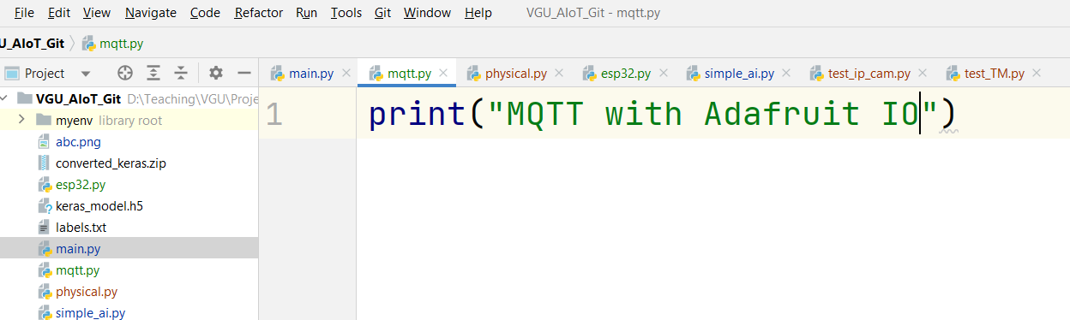
Step 3
Create a new python file:
Named the file link mqtt.py
Run your python file
Student should print to the console a simple string in order to test the Python Editor and Python Interpreter

Slide 18
Step 4
Install the adafruit-io package
pip install adafruit-io

Slide 19
Step 3: Sample Source Code
import sys
from Adafruit_IO import MQTTClient
import random
import time
AIO_USERNAME = ""
AIO_KEY = ""
client = MQTTClient(AIO_USERNAME , AIO_KEY)
client.connect()
client.loop_background()
while True:
time.sleep(10)
print("Your Code Here")
value1 = random.randint(20, 80)
client.publish("sensor1", value1)
#TODO

